Slide 1


Te Tumu Herenga |
Libraries & Learning Services
Ngā Ratonga Manaaki Rangahau | Research Services
Strategic Publishing
Deciding where to publish and understanding the process
Te Tumu Herenga | Libraries & Learning Services
Li Wang & Erin Wood
Notes:
Li

Slide 2

WHAT IS YOUR AREA OF STUDY/RESEARCH?
Whānaungatanga | Tell us a bit about you...
SHARE IN CHAT
Notes:
Li
Whānaungatanga/Tell us a bit about you...
Kia ora koutou, thanks for joining us today. If you wouldn't mind popping some answers up, this will tell us a bit more about you before we get started today. We'll be using the Annotate tool in Zoom throughout the session today, so this is a great chance for you to practise before we get started. To use the Annotate function:
- Hover your mouse at the top of the screen. You'll see a little menu bar pop up.
- Click on View Options, and then select Annotate.
- You can then select the T for text, or use the other tools to stamp or draw on the slide.
Again, we'll be using this function throughout the session today so this is a great time to practise. Also, we've set this to 'anonymous' so there isn't any identifying information that will show on your answers. Let us know if you have any questions, we're happy to help as best we can.

Slide 3
STRATEGIC PUBLISHING
Today we will cover
Follow up session
Finding journals that fit your strategy and research topic
What is Open Access and why should you do this
YOUR STRATEGY
FINDING JOURNALS
PEER REVIEW
OPEN ACCESS
What is your why - what does that mean for your publishing pathway
What to expect when you submit your article to a journal
Notes:
Li
- touching on all of these today
- curious to know which YOU are most interested in learning about, or which are most relevant to you

Slide 4
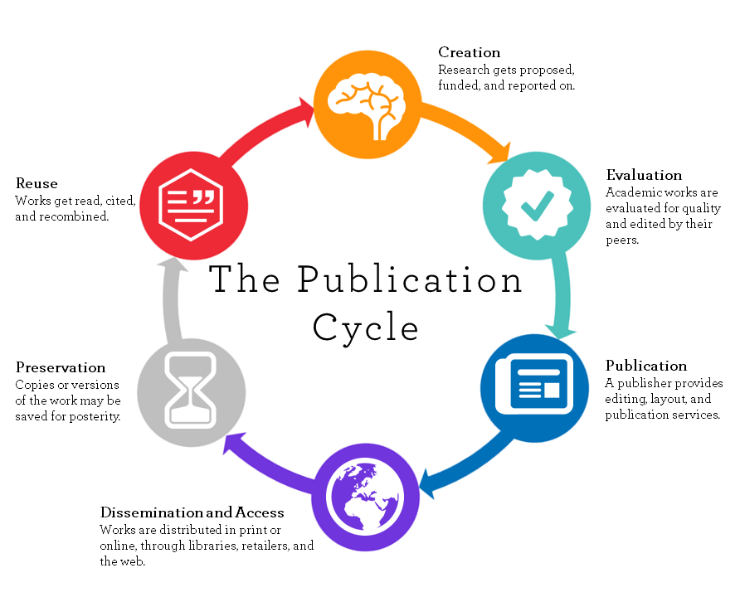
University of Winnipeg
Notes:
Li
- pub cycle at a glance
- today's focus: Evaluation, Publication, Dissemination & Access
- useful to keep in mind that publishing is just one piece of the puzzle, and that there are more steps after that you need to consider
- the decisions you make at an earlier stage of the cycle will affect your options at a later stage of the cycle - so keep this in mind as we talk though this today

Slide 5
WHY IS GETTING PUBLISHED IMPORTANT TO YOU?
He aha o koutou whakāro? | What do you think?
SHARE IN CHAT
Notes:
Li:
- we're keen to know what's driving YOU to publish
- <chat about answers>
- (potential answers: disseminate results, prestige, career progression, job requirements, etc.)

Slide 6




UNDERSTANDING YOUR 'WHY' IS IMPORTANT
WHO
WHAT
WHEN
WHERE
Academics
Industry
Policy makers
Community
1 significant piece or a few smaller pieces
Type of article
Do you have a dataset
Is your research time sensitive
Will you publish during or at the end of your thesis
Local Journal
International Journal
High Impact
Open
Special issue
Notes:
Li

Slide 7

UP NEXT...
CHOOSING A JOURNAL
Notes:
Li to Erin

Slide 8
PUBLISHING EXPERIENCE:
WHERE DO YOU FALL ON THIS SPECTRUM?
We want to know a little more about you...
Never published
Pretty sure I
could run a journal
Published once or twice
Notes:
Erin:
- we're keen to know where you sit on this line
- <chat about the results as they show up - lots of people at the beginning? some in the middle? anyone at the end?>
- great to know, thank you for sharing!

Slide 9
DECIDING WHERE TO PUBLISH
ASK
Who do you want to read your research? (broad/narrow)
What journals are YOU reading?
Where are your supervisor or collaborators publishing?
Do you have to comply with funding or institutional mandates ?
Notes:
Erin:
- Audience: Who is the journal aimed at? Who do you want to read your research? Are these two aligned?
- Think about the journals that YOU read to keep abreast of the current research in your area
- Find out where your supervisor is publishing (and where the published at the beginning of their career), as well as the journals THEY read most often/value highly

Slide 10
DECIDING WHERE TO PUBLISH
ASK
FIND A JOURNAL
JOURNAL FINDER TOOLS
JOURNAL LISTS
OPEN ACCESS PUBLISHING AGREEMENTS
JANE
journal/author name estimator
Journal Citation Reports
(ranked by JIF)
University of Auckland's
Open Access publishing
agreements
&
SCOPUS
(ranked by CiteScore)
Springer Journal Suggester
Open Access Support Fund for high-impact publications
Taylor & Francis Journal Suggester
DOAJ
Directory of Open Access Journals
Notes:
Erin
------------------------------------
Suggesters:
https://jane.biosemantics.org/
https://authorservices.taylorandfrancis.com/publishing-your-research/choosing-a-journal/journal-suggester/
------------------------------------
Example articles:
http://www.journal.mai.ac.nz/content/why-isn%E2%80%99t-my-professor-pasifika-snapshot-academic-workforce-new-zealand-universities
https://pubmed.ncbi.nlm.nih.gov/30925727/
------------------------------------
DOAJ: https://doaj.org/
------------------------------------
OA publishing agreements RHub: https://research-hub.auckland.ac.nz/open-access/open-access-publishing-agreements

Slide 11
DECIDING WHERE TO PUBLISH
ASK
FIND A JOURNAL
CHECK JOURNAL FIT
Scope & aims
Discoverability
Open Access options
Time to publication
Reputation & Citations
Data publishing policies
Copyright policy
Compliance with funder or institutional mandates
Notes:
Erin
Share in chat after discussing this slide:
UOA resource for journal selection: https://research-hub.auckland.ac.nz/article/what-journal-should-i-publish-in
Once you have found some relevant journals, check the journal homepages for the following points to see if it is the right fit for your article.
-------------------------------
Scope & aims: Does your research fit within the scope of this journal? Publication types?
--------------------------------
Time to pub: What’s the estimated timeframe from submission to publication? Most journals will tell you this in advance. Do you have time sensitive content in your research? Is speed of the essence?
------------------------------------
Copyright: Who will get the rights to your research?
Are there limitations on what you will be able to do with your research after it's published in this journal?
----------------------------------
Discoverability: How will people find your research? Where is the journal indexed? How do people access it - paywall/ subscription/OA?
----------------------------------
Reputation & citations:
Prestige and impact factor are not a measure of how well read or cited your work will be. Good research can be in low IF journals, and bad in high IF journals. It is better to think about what your audience reads, or to make your work open to reach a broader audience.
Journal reputation in terms of prestige and impact factor are important considerations for some researchers and some disciplines. Just remember that high prestige journals often have high rejection rates.
--------------------------------
What are your open access options? Will the final version be open via the journal and how much would it cost? If you dont go open with the journal, are you able to share earlier versions of your paper?
Open Access status will determine you be able to distribute your work online

Slide 12
Check out the complimentary ResBaz workshop:
Wednesday 10th July
10:00am - 11.00am
Open Access:
How to Make Your Publications Open
Notes:
Erin
Share in chat:
Register for Open Access session: https://www.eventbrite.co.nz/e/open-access-how-to-make-your-publications-open-tickets-908001917177

Slide 13
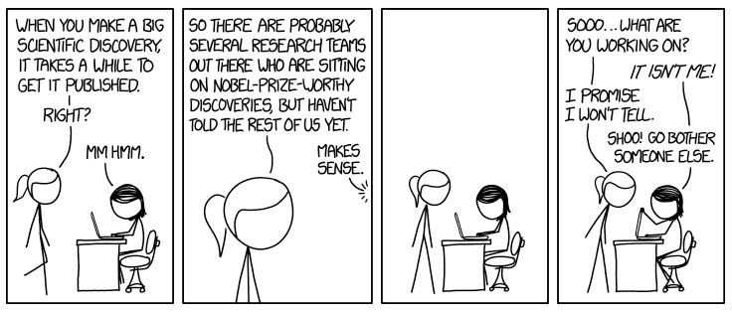

Unpublished Discoveries by xkcd: https://xkcd.com/1805
Notes:
Erin to Li

Slide 14

UP NEXT...
PUBLISHING PROCESS
Notes:
Li

Slide 15
HOW LONG DOES THE PUBLISHING PROCESS TAKE?
He aha o koutou whakāro? | What do you think?
~1 month
1-3 months
3-6 months
6-12 months
12+ months
Notes:
Li:
Here we'd like to to have a guess at how long you think the publishing process takes. Remember - there are no wrong answers!
<chat about the answers>

Slide 16
ACADEMIC PUBLISHING TIMELINE
(a theoretical example)
Peer review
Second peer review
Publication
1-4 WEEKS
3-4 WEEKS
2-4 WEEKS
2-4 WEEKS
1-4 WEEKS
?
Initial manuscript review
Manuscript w/ author for revisions
Formal acceptance
(Total time to completion: 9-20+ weeks)
Based loosely on PLOS - Understanding the Publishing Process
Notes:
Li
<Talk through the stages. In this example, the shortest timeframe from start to finish is at least 9 weeks (just over 2 months), whereas the longest is at least 20 weeks (4 months). Mention that these timeframes can actually be quite a lot longer - it may be up to a year (or longer) from start to finish.>
Academic publishing timelines vary quite a lot - if your data is time sensitive, you may want to use a preprint server. If this sounds like your research and you want to more about this, you can contact the library through Ask Us and and one of the team can help you with this.

Slide 17











THE PEER REVIEW PROCESS
manuscript may be sent for another round of peer review
blind review
manuscript may be rejected
manuscript
rejected
double blind review
journal editor reassesses
manuscript
author submits manuscript to journal
journal editor assesses manuscript
manuscript sent for peer review
transparent review
manuscript
approved
manuscript sent to author for changes
open review
adapted from BioMed Central
Notes:
Li:
This seems overwhelmingly complicated, I know. But stick with us - once we talk through the stages it will make sense. It's important for you to understand that there are no shortcuts to peer review, and every time you go through this process, it might be slightly (or very! different.
AUTHOR SUBMITS:
Each journal will have its own set of guidelines for manuscript submission, formatting, layout, etc.
JOURNAL EDITOR ASSESSES MANUSCRIPT:
- editor is assessing for quality, significance, scope alignment, ...?
Potential outcomes of initial assessment:
1) rejected (why: out of journal scope, not enough prestige/significance in the research topic)
2) accepted with major revisions
3) accepted with minor revisions
4) accepted without review
MANUSCRIPT SENT FOR PEER REVIEW:
- your manuscript may be scrubbed of any identifying data before being sent out - this can also take time
Types of review:
1) Blind: the author doesn't know the identity of the peer reviewer(s)
2) Double-blind: neither the author NOR the peer reviewer(s) know the identities of the other parties
3) Transparent: the peer review report is published alongside the article
4) Open: the author and peer reviewers know the identities of the other parties
MANUSCRIPT SENT BACK TO AUTHOR FOR CHANGES:
- author then makes adjustments & corrections to the article as requested by the peer reviewers
JOURNAL EDITOR REASSESSES MANUSCRIPT:
- editor reassesses corrected article
- they may then send the article back for another round of peer review (this can happen multiple times)
- they may STILL reject the article (?DM explain?)
- they may approve the article for publication

Slide 18
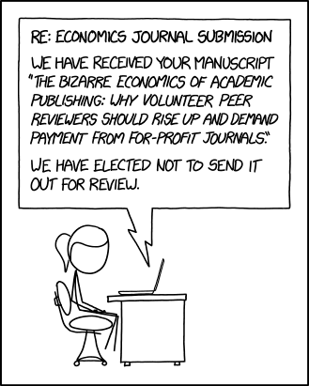
Peer Review by xkcd: https://xkcd.com/2025
Notes:
Li to Erin
ALSO mention here:
- you can gain experience in academic publishing by being a peer reviewer (useful for early-career researchers)
- however, on the downside, peer reviewers aren't paid
- Publons: a platform that lets you get credit for your peer review contributions without breaking blind review protocols; you can use Publons to gather metrics on your activities as well as data for promotions or funding/grant applications

Slide 19

UP NEXT...
AFTER PUBLISHING
Notes:
Erin

Slide 20






SO YOU'VE FINALLY PUBLISHED...NOW WHAT?
6
5
4
LOOK FOR CHANCES TO COLLABORATE
3
TRACK YOUR METRICS
2
ENTER ACADEMIC DISCUSSIONS
1
UPDATE YOUR PROFILE(S)
DEPOSIT IN REPOSITORY
UPDATE YOUR ORCID
Notes:
Erin
Go to ORCID: https://orcid.org/
ORCID guidance at UOA: https://research-hub.auckland.ac.nz/researcher-profiles-and-ids/orcid
-----------------------------------
ORCiD: Does anyone have an ORCiD already? You can pop and answer in the chat or use thumbs up/down.
ORCiD is kind of like an IRD or Social Security number for your research. (?Donna, is this too NZ-specific?) An ORCiD is an identification number that you can use across different platforms and publication types so that your work is associated with YOU and not another researcher on the other side of the planet who has the same name as you.
------------------------------------
UoA Repository: ResearchSpace, Figshare, Research Outputs. Remember how we mentioned Green Open Access? This is where you can put your accepted version to fulfil the Green OA system. Google Scholar uses our repository as a trusted source, which means it will pull your data out and put it higher up in the search results because it comes from a trusted. DO NOT MENTION
----------------------------------
Researcher profiles resources at UOA: https://research-hub.auckland.ac.nz/subhub/researcher-profiles-and-ids
Update your profiles:
Most universities and institutes will have a professional profile for you - make sure you update these too. UoA has Discovery profiles available to doctoral candidates and staff. Its the first item that will come up when you google yourself - make sure it represents yourself well! If it is empty or a rush job, you could potentially be depriving your future self of opportunities for advancement and collaboration.
These can be your social media, such as LinkedIn, Facebook, Twitter, if you use it for sharing your research. Add information about what you have published - if it is open access share the article and images from the publication or from the research process. If you have decided not to publish open, link to the publishers page and to the item in the repository. The wider you share your work, more readership and engagement you will get and the greater the impact your work can have on the world.
--------------------------------
Academic discussions: Not just share your work but participate in discussion with your peers - attend conferences, find where your discipline is active on social media, join mailing lists and discussion with communities of practise
--------------------------------
Metrics: use DOI, ORCiD, different academic profiles (e.g. GoogleScholar, Scopus, ?Dimensions); claim publications on various platforms; find out what’s getting tracked & where (e.g. Altmetrics diagram?)
------------------------------------
Collaboration: the more you engage, the higher your chances of collaboration with others. Collaboration -> new research -> new publications -> more visibility/prestige/influence/impact/better metrics (wash, rinse, repea

Slide 21
Image credit:
University of Winnipeg
Notes:
Erin
…which brings us back to the publication cycle. Hopefully this session has helped clarify and explain the various stages in the process. Where are you in this cycle? How will you think about the next stage in the process? How will you apply what you learned today to your own research and publication strategy? What is still unclear for you? What would you like to look into a bit more?

Slide 22

Check out the complimentary ResBaz workshop
Open Access:
How to Make Your Publications Open
Wednesday 10th July
10:00am - 11.00am
Pātai / Questions
Notes:
Erin
Share in chat
Register for Open Access session: https://www.eventbrite.co.nz/e/open-access-how-to-make-your-publications-open-tickets-908001917177

